Slide 1


Should we use purpose-specific vocabulary learning strategy?
Jason Moy
Advisor: Timothy Rickard Ph.D
Notes:
In this experiment, I want to investigate whether we should use purpose-specific vocabulary learning strategy. I know it is confusing right now, but I will explain.

Slide 2
Learning a New Language
Vocabulary is an essential component of learning a new language
Ways to learn new vocabulary (large amount & short period)
  Restudy
  Self-test
Notes:
People usually use either restudy or self-test technique to learn a large amount vocabulary in a short period of time)

Slide 3
Vision
visión
视力
전망
ビジョン
видение
Notes:
In the initial study condition, they viewed the English term and its corresponding translation simultneously

Slide 4
Vision
Please type the translation of “Vision”:

Slide 5
Testing Effect
Practice test = better memory
Expect self-test technique is better
Notes:
When we tried to understand which method is more effective, a closely related concept in the previous literature is known as the testing effect.

Slide 6

Procedure of Testing Effect Experiments
Initial Study
Post-test
Pre-test

Slide 7
Vision
visión
视力
전망
ビジョン
видение
Notes:
In the initial study condition, they viewed the English term and its corresponding translation simultaneously

Slide 8
Procedure of Testing Effect Experiments
Initial Study
Training
Post-test
Notes:
So, people have conducted experiments to see whether that’s the case or not

Slide 9
Vision
visión
视力
전망
ビジョン
видение
Notes:
What do I mean by restudy strategy?
For example, if you want to learn English. You can restudy the term and its corresponding translation repeatedly.

Slide 10
Vision
Please type the translation of “Vision”:

Slide 11
Procedure of Testing Effect Experiments
Initial Study
Training
Post-test

Slide 12
Vision
Please type the translation of “Vision”:
Notes:
You will once again take the test that is identical to the practice test that people in the self-test technique have taken.

Slide 13

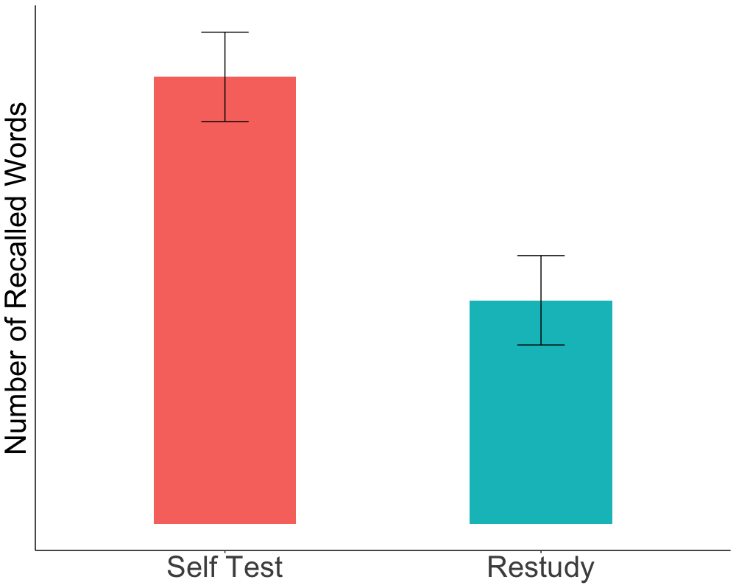
Result
Notes:
df1 = read_csv('http://vulstats.ucsd.edu/data/duckworth-grit-scale-data/data-coded.csv')
mean = c(10,5)
df1 %>%
filter(gender %in% c('male','female')) %>%
group_by(gender) %>%
summarise(mean.neuroticism = mean(neuroticism),
se.neuroticism = 1) %>%
ggplot(aes(y = mean, x = gender, fill = gender)) +
geom_col(width = 0.45) +
geom_errorbar(aes(ymin = mean - se.neuroticism,
ymax = mean + se.neuroticism), width = 0.15) +
labs(x = NULL, y = 'Number of Recalled Words') +
scale_x_discrete(labels = c("female" = ”Self Test", "male" = "Restudy")) +
scale_y_discrete(labels = NULL) +
theme_classic() +
theme(legend.position = 'none') +
theme(axis.text.x = element_text(size = 30)) +
theme(axis.title.y = element_text(size = 30))

Slide 14
Research question
Compare to restudy control condition, do people recall more words if the direction of the final test is different from the practice test?
Notes:
Now, people tends to better on the final test if they have taken a identical practice test. What if the direction of the practice test is different from the final test? Are people practice that way still perform better than people simply restudy?

Slide 15
Vision
Please type the translation of “Vision”:
Notes:
For example, if the practice test asks you to recall the first language translation, then the final test will ask you to recall the second language term.

Slide 16
视力
Please type the English term for “视力”:

Slide 17
Practical Implication
Reversed Test = Identical Test: Nothing change (yea!)
Reversed Test < Identical Test: People should adopt purpose-specific vocabulary learning strategy
Notes:
If the performance on the final test is same for people when they take a reverse practice test and the identical test, then nothing change
But, if the performance on the final test is worse for people when they take a reverse practice test compared to when they take a identical test, then they should use the purpose-specific vocabulary learning strategy

Slide 18
Purpose-specific Learning Strategy
English-Chinese:
Chinese-English:
Mixed:
translator, studying GRE
retired immigrants
International students
Notes:
Purpose-specific learning strategy basically mean that whether you should choose your learning strategy based on your goals and occupation.
There are three different type of learning strategy.
Imagine you have a job of translating a English novel into Chinese, Obviously, you need to recall the Chinese more frequently. If a reverse practice test is worse than a identical practice test, then you should always practice with identical test. That meant that you should always studying by recalling Chinese given the English.
Now, Imagine you are retired, and you immigrate to the US. Then, you are more likely need to communicate with people around you. So, you need to recalled English more often with the Chinese word in your mind. So, you should practice recalling English given the Chinese more often.
If you are a international student, you probably need to read book, which require recalling Chinese, and communicate, which require recalling English, So you probably should practice using both strategy. Otherwise, you may be particularly good at communicate but bad at reading, or vice versa. However, it also depends of your goal of studying. If you are studying for GRE, then you should practice recalling Chinese more often since you are given a English term in the GRE require you know the meaning.

Slide 19
Present Research
Focus on transfer effect between Chinese & English vocabulary
Recruit UCSD students who are proficient in both Chinese and English

Slide 20
Procedure
Initial Study
Training
Post-test

Slide 21
Vision
visión
视力
전망
ビジョン
видение
Notes:
What do I mean by restudy strategy?
For example, if you want to learn English. You can restudy the term and its corresponding translation repeatedly.

Slide 22
Training
45 Pairs
Within-subject
English-Chinese
Chinese-English
Restudy
Notes:
15 pairs of word will be studied by recalling the Chinese translation given the English term. Another 15 pairs will be studied by recalling the English term given the Chinese translation. The last 15 pair of words will be restudy.

Slide 23
Final Test
English-Chinese
Restudy
Chinese-English
Testing Effect
Transfer effect
English-Chinese
Notes:
People will only take one final test.

Slide 24
Participants
English-Chinese Final Test
Chinese-English Final Test
English-Chinese
Restudy
Chinese-English
English-Chinese
Restudy
Chinese-English

Slide 25
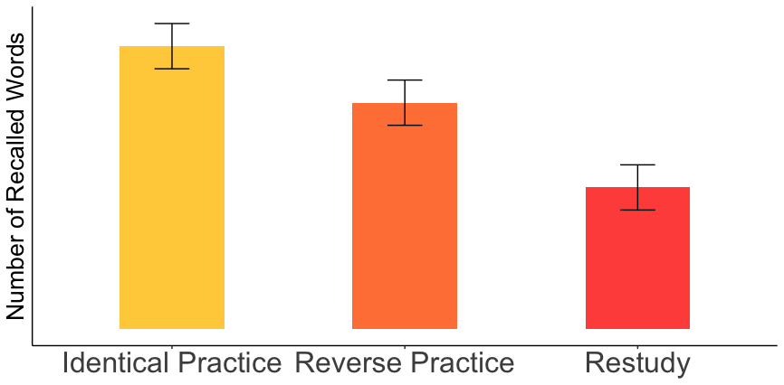
Hypothesis
Notes:
df1 = data.frame(condition = c('Test Same', 'Test Different', 'Restudy'))
mean = c(10,8,5)
se = c(0.8,0.8,0.8)
df1 %>% group_by(condition) %>%
ggplot(aes(y = mean, x = condition, fill = condition)) +
geom_col(width = 0.45) +
geom_errorbar(aes(ymin = mean - se,
ymax = mean + se), width = 0.15) +
labs(x = NULL, y = 'Number of Recalled Words') +
scale_y_discrete(labels = NULL) +
theme_classic() +
theme(legend.position = 'none') +
theme(axis.text.x = element_text(size = 30)) +
theme(axis.title.y = element_text(size = 30)) +
scale_fill_manual(values = c("Restudy" = "#ff5349" ,
"Test Different" = "#ff8243" ,
"Test Same" = "#ffcf48"))

Slide 26
Future Direction
A optimal mixture of both learning strategy for some groups (e.g. international student)
Replicate the current study using different language
Replicate the current study with pronunciation or picture-translation

Slide 27
Question?
Advice?

